Slide 1



Victoria Mollard | Executive General Manager, Economics and System Security, AEMC
Cybersecurity and resilience in energy infrastructure
Australian Energy Market Commission | 24 September 2026

Slide 2
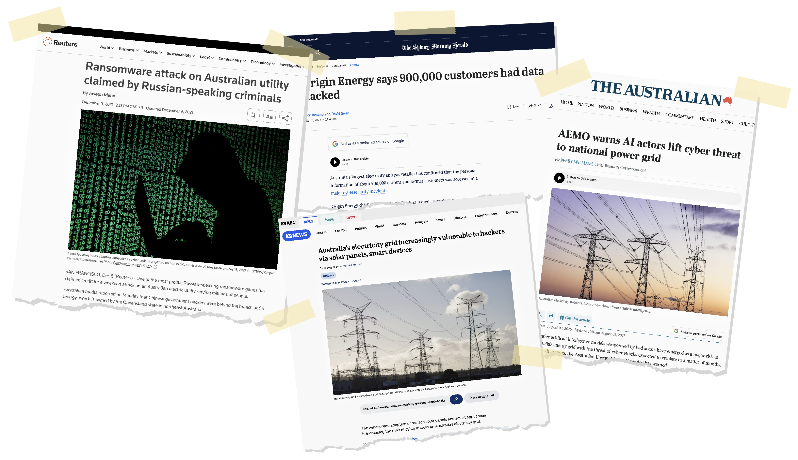
An ever-present and evolving threat

Slide 3

Cybersecurity frameworks
1. Security of Critical Infrastructure Act - what security obligations do businesses have?
2. Australian Energy Sector Cyber Security Framework - how mature is our cyber security capability and where should we improve?
3. Australian Energy Sector Cyber Incident Response Plan - what do we do, and who does what, when a serious cyber incident occurs?

Slide 4
Distributed roles, coordinated response
National capability and policy
Australian Signals Directorate through the Australian Cyber Security Centre Technical cyber expertise, threat intelligence and incident support
Department of Home Affairs through the Cyber and Infrastructure Security Centre Critical-infrastructure regulation and government coordination
Department of Climate Change, Energy, the Environment and Water Energy policy, sector resilience and development of cyber reforms
Energy governance and coordination
Australian Energy Market Operator (AEMO)
Energy-sector coordination
Australian Energy Market Commission (AEMC)
Independent energy rule-maker
Rules made to:
Formalise AEMO’s cyber functions
Enable cost recovery and liability protection
Electricity &
Coordinate Major cyber incident response
Prepare Industry capability & exercises
Advise Government and industry on risks
Share Critical
cyber information
Gas
Industry responsibility
Energy businesses
Energy businesses Remain responsible for protecting their own assets, systems and information
Information sharing and coordinated response

Slide 5


Testing plans under pressure
Exercise Trident
Hosted by the Australian
Energy Market Operator
Annual cyber security and emergency preparedness exercise bringing together government and energy industry participants
Tests how the sector responds to a hypothetical, large-scale, coordinated cyber incident impacting critical energy systems and market operations.
Builds resilience and coordination across the sector in the event of a real-world event
Australian Energy Market Commission | 24 September 2026
5

Slide 6
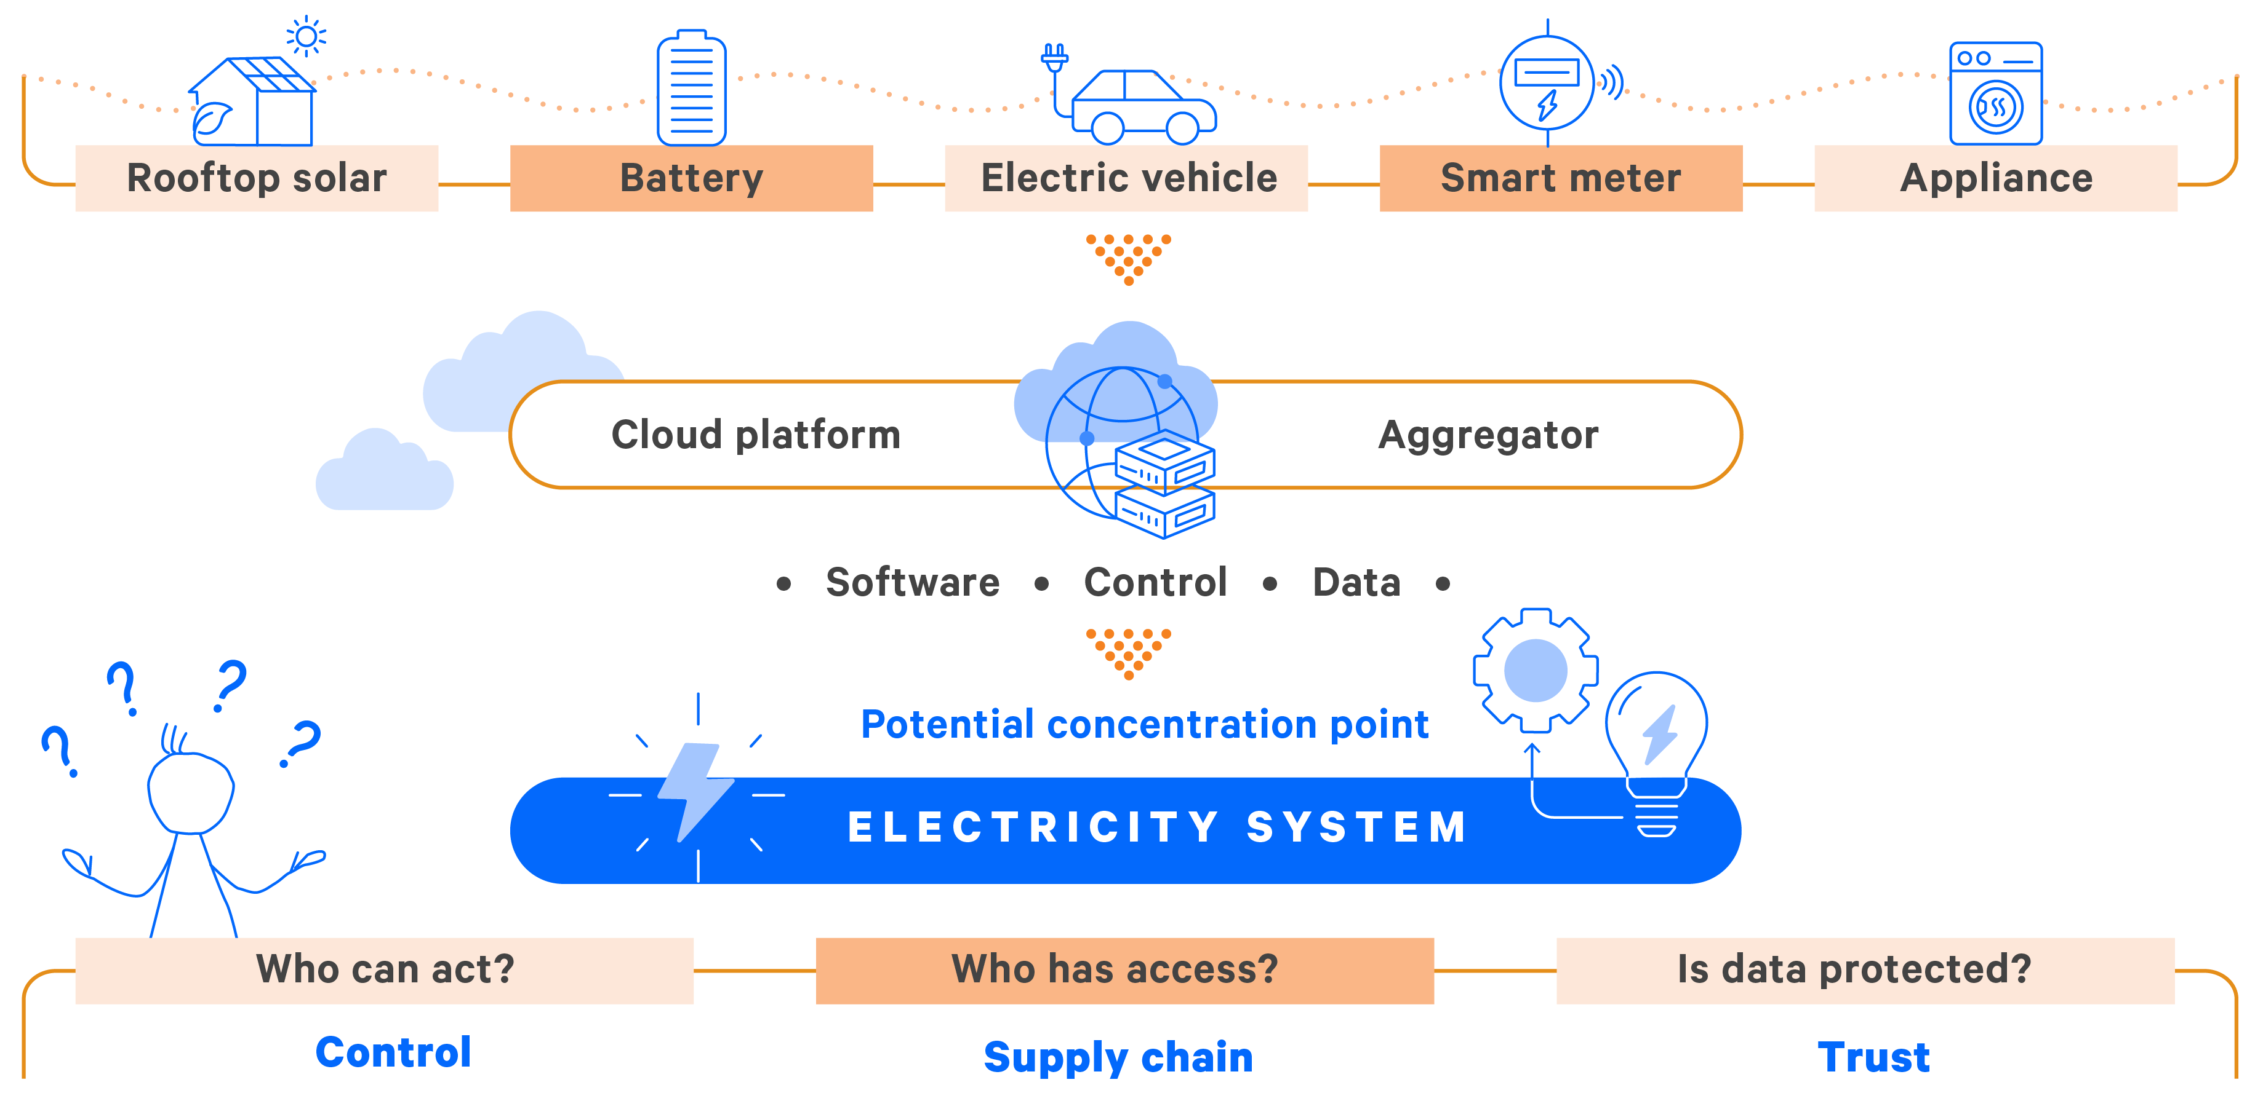
Consumer energy resources: distributed assets, shared cyber risks

Slide 7
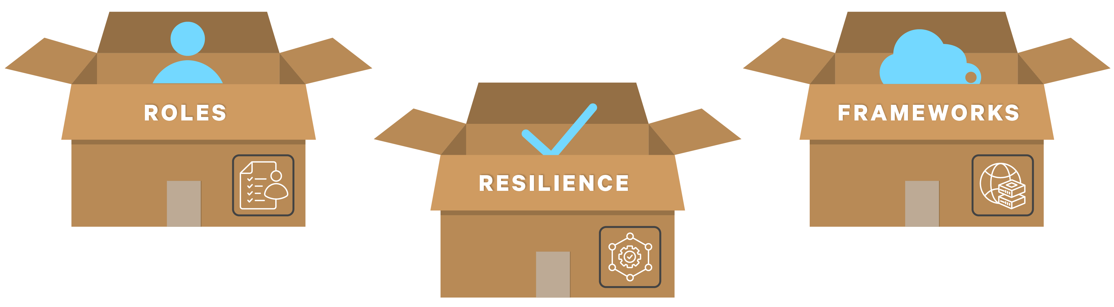
Practical lessons from Australian cybersecurity experience
1
3
Formal arrangements need regular testing to improve resilience
Roles and responsibility must be clear
Frameworks must keep pace with technology
2

Slide 8
Cyber security and resilience in energy infrastructure
Victoria Mollard
Executive General Manager, Economics
and System Security, AEMC

